Slide 1
Creativity and Innovation in the classroom
22 February 2018
Sesimbra, Portugal
Eglė Vaivadienė, Lithuania, eglevaivadiene@gmail.com

Slide 2
Which program are you using in education?
21. Windows Live Movie Maker
22. GoAnimate
23. Animoto
24. Top frame animation
25. Book Ctreator
Eclipse Crossword
Edraw Mind Map
Pencil
Sketch Star
Wink2
Bingo
Imagine Logo
Mindmanager
My Heritage
Timetoast
Evernote
Geogebra
Learn!
ArmoredPenguin.com
Jimdo
iBook Author
iPhoto
iMovie
Sock Puppets
StoryKit

Slide 3
10 Apps for Creativity
Evernote . First help for creative person, it is cross-device easy-to-use app which stores your notes, photos, to-do lists and make it all searchable and accessible from web, smartphone or tablet.
Clear Nice-looking list-keeping app that is really simple, quick and easy to use, no matter if you are creating notes or to-do lists.
Creative Whack Pack Set of funny cards which should provoke your thinking. It contains 84 interactive creative strategies which should stimulate creative thinking.
Unleash Your Creativity Well, I have to confess, that this is the app that I created, but I really use it often. Quick intro should be: A help for every creative who needs a guide how to create/reshape/finish ideas with advices & place to store your notes.
MindTools Useful app with lot of content. It’s a guide not only for creativity, but also for other business skills such as leadership, strategy, project management and problem solving.
Oflow Set of more then 100 ways to get you into the creative flow. Also containing notes, reminders & favorites sections with possibility to flag, browse and email favorites.
Innovate All posts from Innovation Excellence in one app. Other highlighted sections are TED videos, AC Podcasts and FastCompany News, but also other content such as Business Week, or The99% are available.
The Brainstormer This funny and nice-looking app combines three spinning wheels with plot/conflict, theme/setting and subject/location. After spinning the wheels, generated combination make creative inspiration very simply.
iBrainstorm Multi-device collaboration tool for brainstorming which is used like a pinboard with sticky notes and ability to draw. So, ideas can be written and organized as groups and projects.
Behance Network: Creative Portfolios & Galleries This is maybe different then all previous apps… By browsing through the hundreds of galleries of highly talented persons, you can be inspired for new ideas. Also, everyone can build up their portfolio as well

Slide 4
The photography as a tool in teaching and learning
Photo Story 3 for Windows
Auto Collage

Slide 5
Digital Photography in Teaching & Learning
How digital photography can be used in teaching, learning? Here are some examples:
Use a series of photos to tell a story or virtual adventure
Historic Fort using Comic Life,
Museum slide show,
Virtual Museum
Use a series of photos to demonstrate a process (i.e., making a sculpture) or cycle (i.e., life cycle of a tree).
Felting instructions, felt making
Pepper Water Demonstration
Checkout Demonstration
Seed to Sapling
Use a series of photos to make a comparison such as right/wrong or correct/incorrect.
Compare/Contrast
Use photos to show how items can be organized or categorized.
Use photos as story starters or to stimulate thinking.
Use photos for visualizing vocabulary or labeling parts.
French Vocabulary

Slide 6
Digital Photography in Teaching & Learning
Photo story 3 for Windows
Microsoft autocollage
Graphic Apps: http://graphic-apps.software.informer.com/
Photo editing, Photorealistic Montages: http://funny.pho.to/
http://www.picisto.com/ http://www.glitterphoto.net/ http://www.loonapix.com http://www.enjoypic.com/
Etc.

Slide 7
AutoCollage
What is AutoCollage? Photo collages celebrate important events and themes in our lives. Pick a folder, press a button, and in a few minutes AutoCollage presents you with a unique moments to print or email to your family and friends.
Download:
Pros
Automatic operation.
Fair Price.
Small application.
Easy-to-use.
Very Fast.
Cons
Very high processor load.
Few features to customize.
Drag-and-drop not available.
Cannot select sub-folders.
Notes:
You can create a composition from existing photos.

Slide 8
Notes:
Students have to write the names of musical instruments.

Slide 9
Film Education in UK
Film Education is a charity by the UK Film Industry. It promotes and supports the use film within the curriculum: http://www.filmeducation.org/index.php

Slide 10
Film & Animation in education
Programs:
Movie Maker, Windows Live Movie Maker
GoAnimate
Animoto
Pencil
Top frame animation
Wink2
iMovie (MacOS)
Sock Puppets (iOS)
Etc.

Slide 11
Creation of Crosswords
using Eclipse Crossword program
http://www.eclipsecrossword.com/
Notes:
EclipseCrossword is the fast, easy, free way to create crossword puzzles in minutes.
It's never been simpler—just give EclipseCrossword a list of words and clues, and it does the rest. In seconds, you'll have a crossword puzzle with just the words you want.
Crossword puzzles encourage logical thinking and correct spelling. Crosswords can be printed or uploaded to your website.

Slide 13
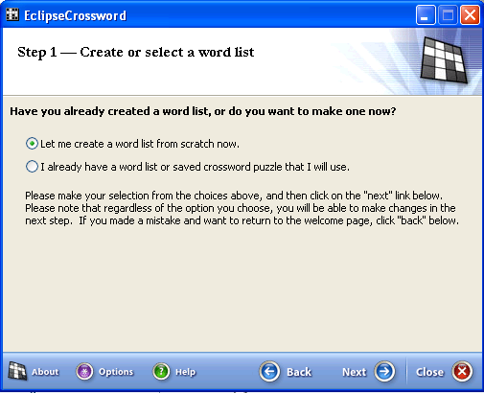

Slide 14
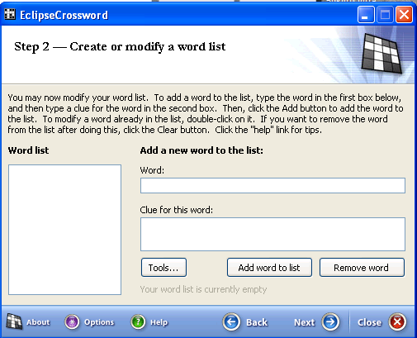
Write a response
Write an question
Click on
When all questions and answers are written, click on „Next“

Slide 15
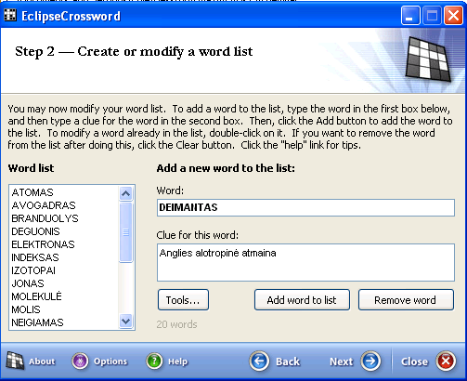

Slide 16
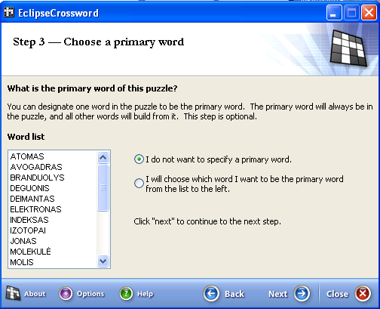

Slide 17
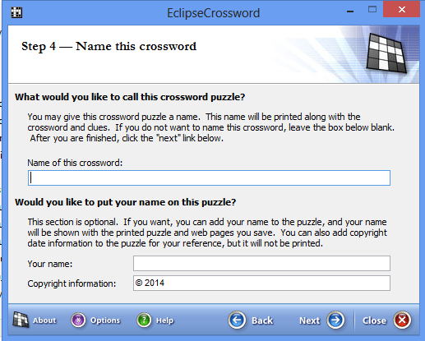
Enter the name of the crossword
Write the name of the author
Click on „Next“

Slide 18
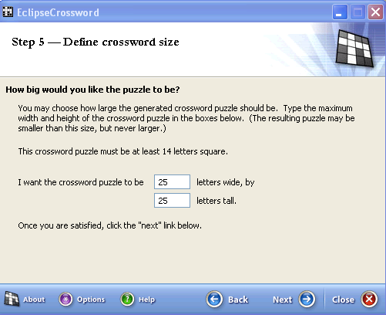
Click on „Next“

Slide 19
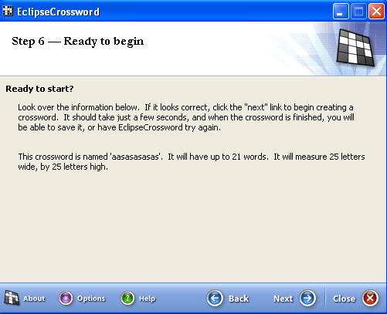
Click on „Next“

Slide 20
Comics creation tools
http://www.makebeliefscomix.com/
http://www.bitstrips.com/create/comic/
http://www.pixton.com/
http://en.uptodown.com/search/free-comic-maker-software
http://www.readwritethink.org/files/resources/interactives/comic/index.html
http://www.befunky.com/
How to create?
http://vimeo.com/1075052
More about comics: Comics as an Educational Tool

Slide 21
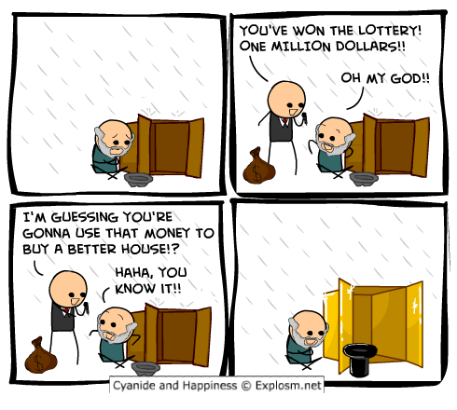
Comics
http://hahawtf.blogspot.com/p/funny-comics.html

Slide 22
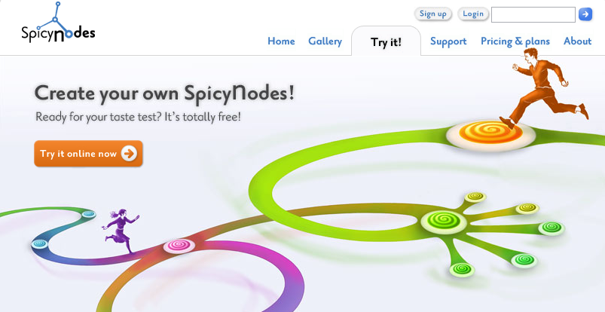
Mind maps
E-draw Mind Map,
Mind Manager,
Inspiration
Kids Inspiration
http://www.spicynodes.org/index.html
Etc..

Slide 23
Tag Cloud
http://www.wordle.net/gallery
http://www.tagxedo.com/app.html

Slide 24
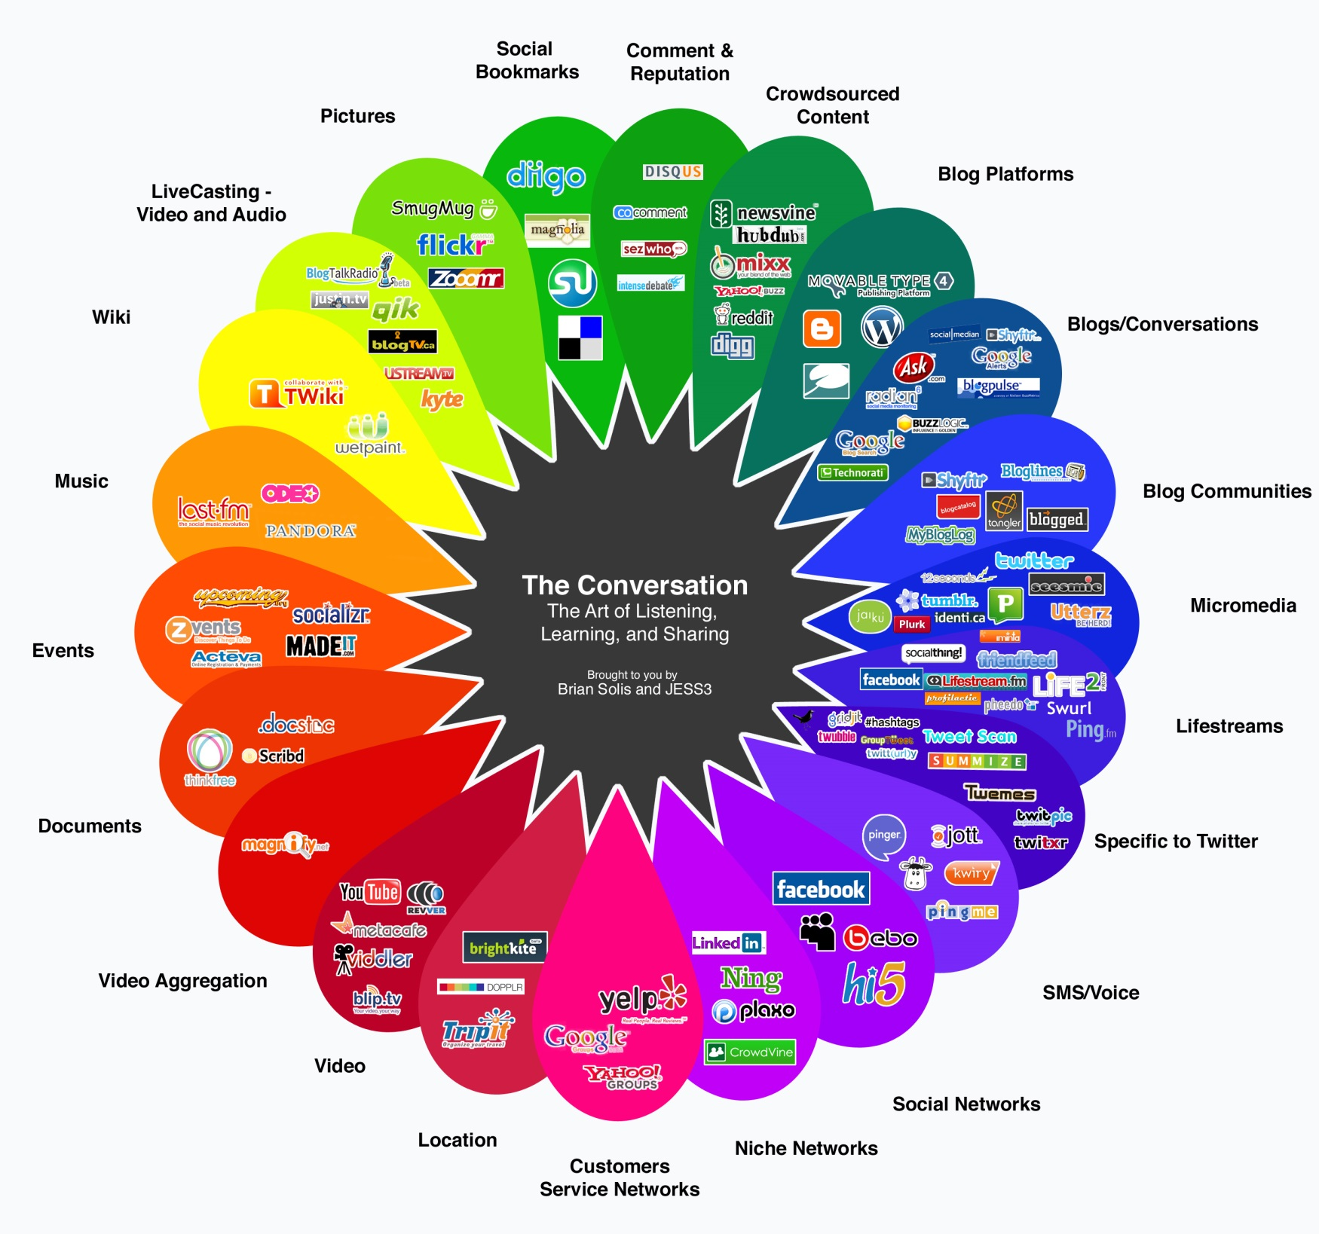
http://elprincipederancagua.files.wordpress.com/2010/05/web-2-0.jpg

Slide 25
Free Teacher Technology Tools
Animated Educational Arcade
Classroom Calculators
Educational Games
Free Email Accounts
Hand Writing Simulator
Online Calendar Maker
Take Our Teacher Poll!
Teacher Message Board
Teacher Motivator
Teacher Software
Web Site Maker
Weekly Teacher Tips Newsletter

Slide 26
Useful links
Online web tools for creative educators & trainers
15 Free Tools for Web-based Collaboration:
Virtual Classroom Software
Tools for educators – Free tools for teaching - printable worksheets, board games, Crossword, Maze, Domino, Bingo, Puzzle Maker, classroom printables and on-line worksheet templates with images.
31 Free Social Bookmarking Tools For Educators
What’s APPening in Microsoft Education
Top free apps

Slide 27
You may also find the following lists of tools useful:
21 Free Digital Storytelling Tools For Teachers and Students
List of 13 Free Sticky Notes Tools for Teachers and Students
14 Best Online Bibliography and Citation Tools
15 Free Web Conferencing Tools
List of 15 Free Google Tools for eLearning Professionals
23 Microsoft Free Teaching Tools for Educators
List of 18 Free Tools to Create Infographics for your Learners
15 Social Learning Tools Every Online Educator Should Know About
List of 17 Free Screen Capturing Tools
15 Free Podcast Tools
Ultimate List of 34 Free Music for eLearning Development
27 Free Survey Polls Quizzes Tools for eLearning
List of 32 Free Photo and Image Editing Tools
15 Free Testing and Quizzing Tools for Online Education
List of 72 Free Storyboard Templates for eLearning
19 Free Text To Speech tools for Educators

